Slide 1
PhotoVoice Introduction
By: Damian Sclafani

Slide 2
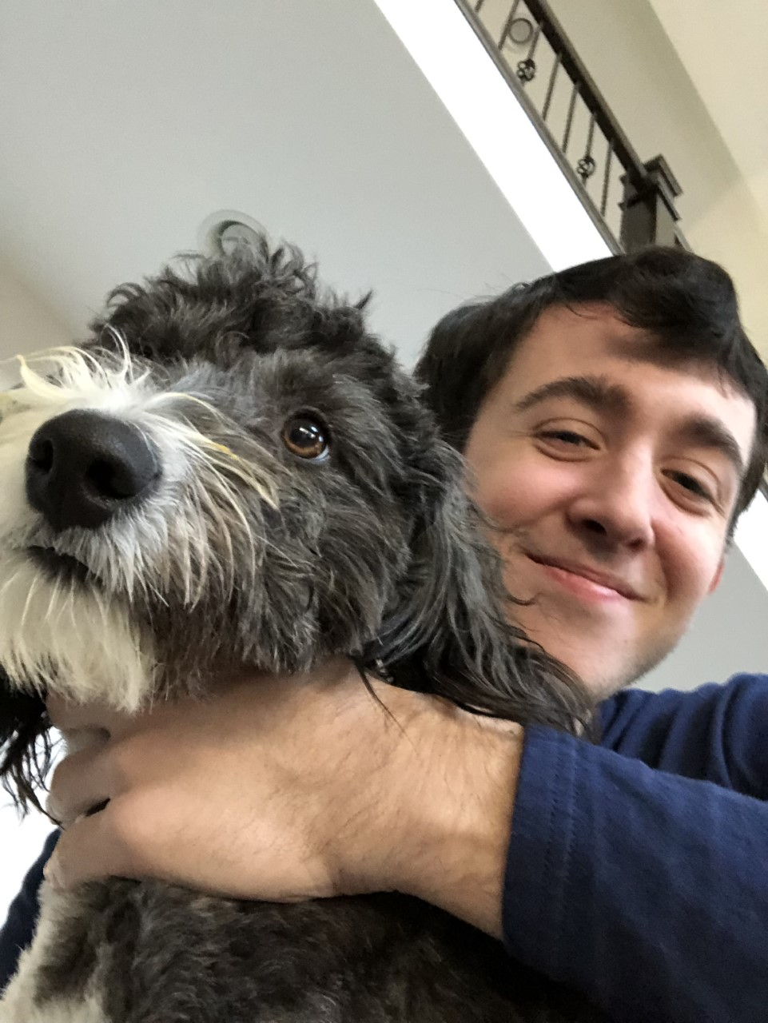
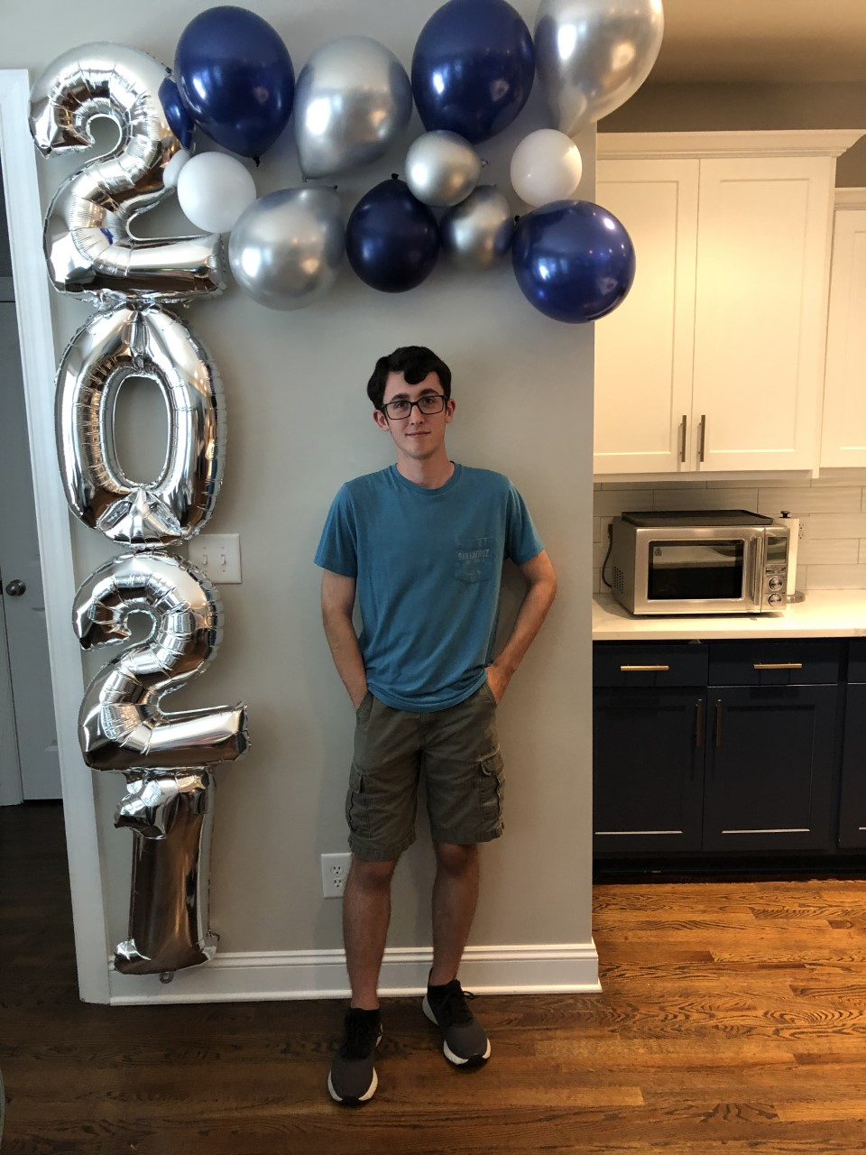
Who am I?

Slide 3
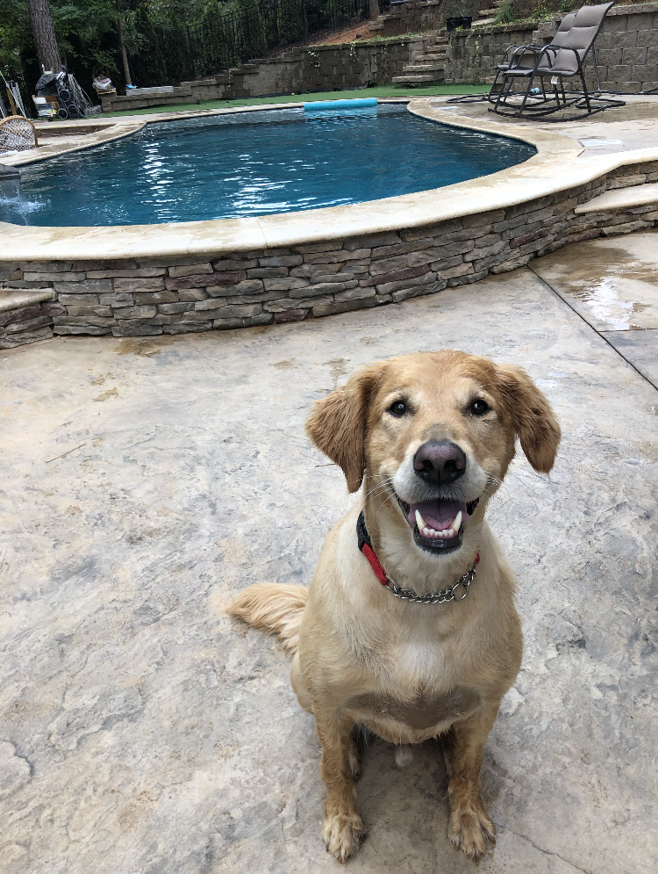
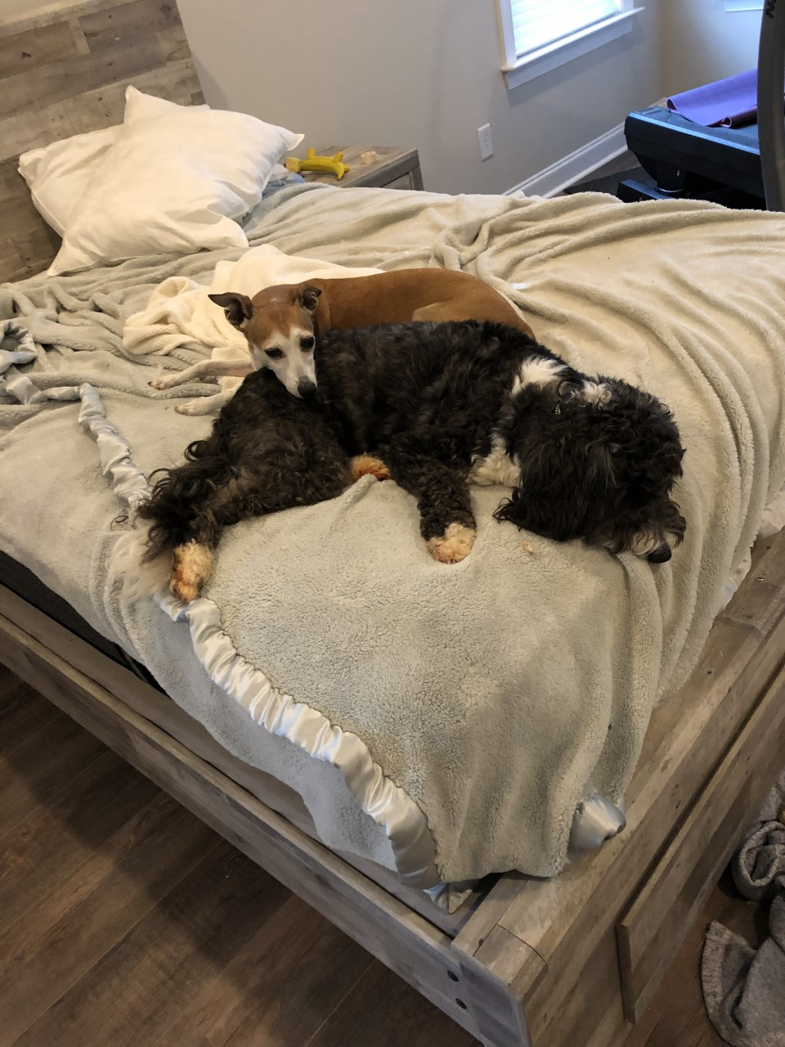
My Dogs!

Slide 4
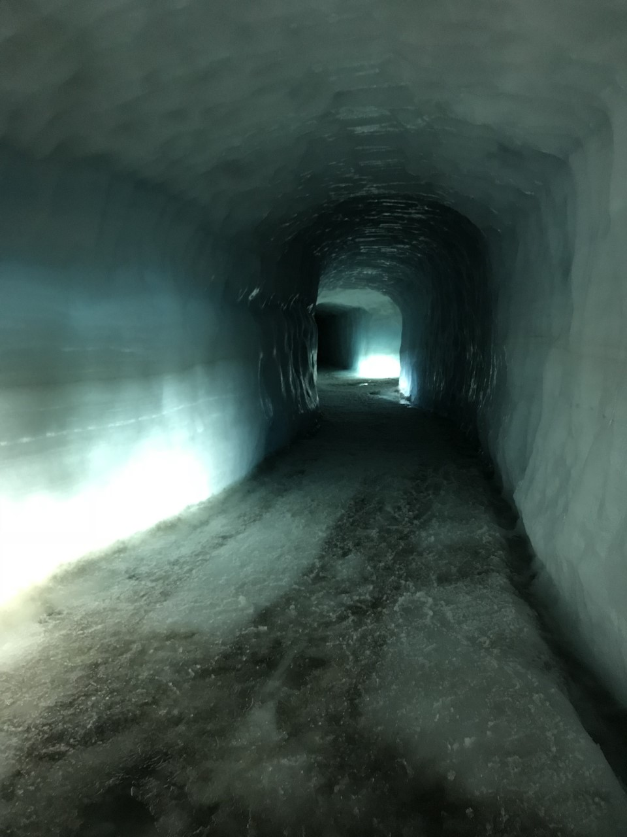
My Trip to Iceland

Slide 5
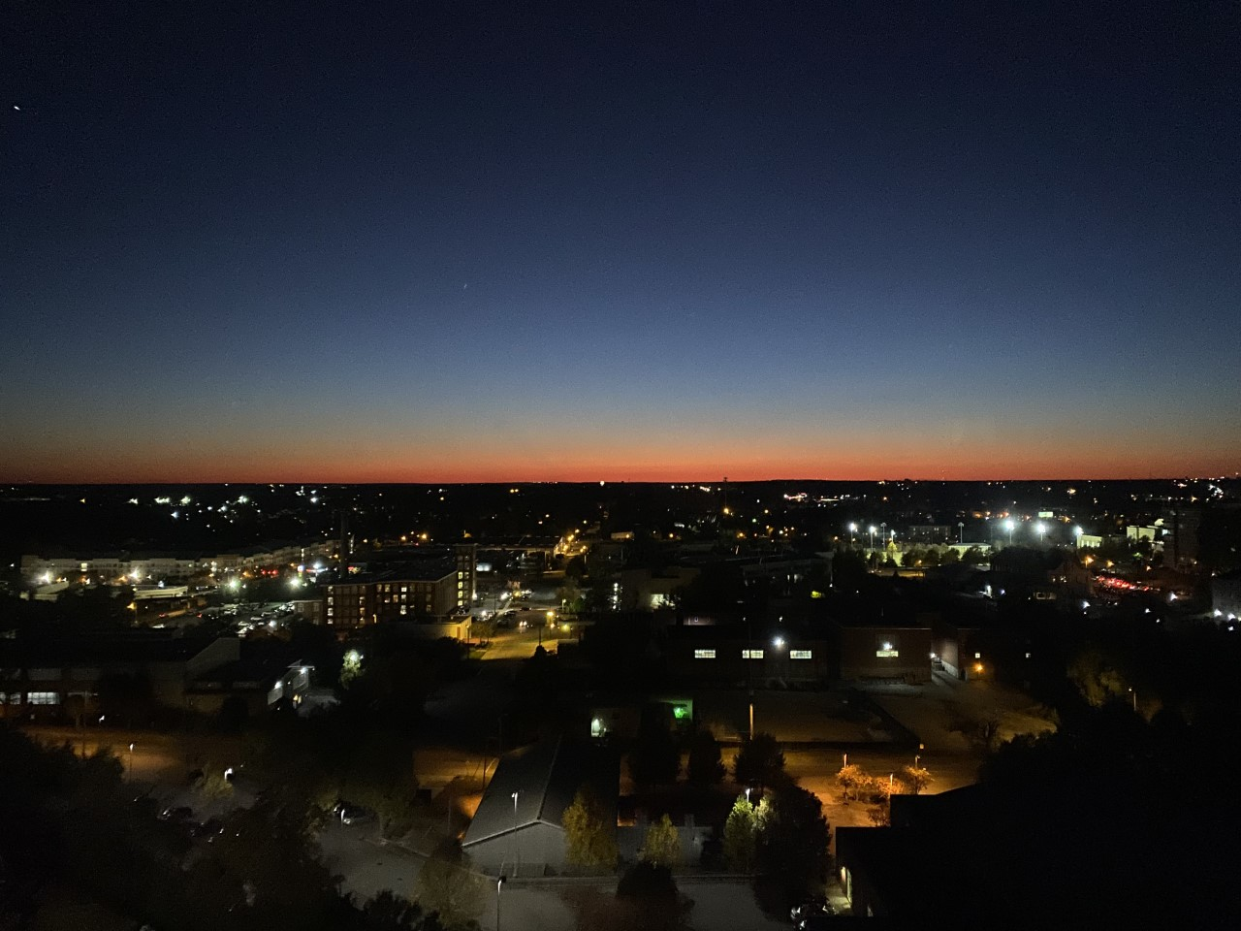
My Life at UofSC Starts Now!

